Slide 1

Phone holder.
KCK Enterprise
By :
NGUEKO TCHINDEU Karl Friedrich.
KAPNANG KETCHEZEU Johan Lael.
AYENG OWONO Gladys-Darcell.

Slide 2

Summary
INTRODUCTION.
CONCEPTION.
FUNCTIONS.
EXPENSES.
Betting on the market.
Environmental Effects.
FAILURES.
CONCLUSION.

Slide 3
A. INTRODUCTION
The Phone Holder was imagined and designed to permit free and easier movement (rotation) of a phone.
Our objective was to achieve that goal, make it possible in the simplest way it can be.
The issues was to attempt the project and acquired knowledge from it.

Slide 4
B. CONCEPTION.
So far as we went, we did the following;
Drawn the mock-up(phone holder) and realize it using the 3D printer in the FABLAB. « MEC »
Done the electrical connection of the phone holder. « EEE »
Wrote a code (or program) to control the stepper motor using a joystick in the IDE Arduino. « MIA ».

Slide 5
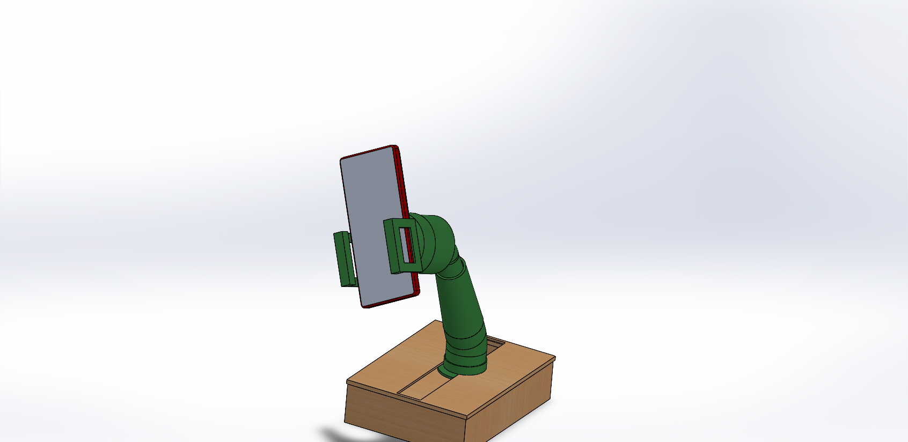
DOMAINS
MEO: Our project plan was design to start by the Structure in order to place the circuit and then implement the code.
MEC: Our phone holder is acts on the user for him/her to Aurelian hold his phone and adjust his angle of view without any strain using the joystick.
EEM: The base of our phone holder if made out of wood and its upper part is made of ABS.

Slide 6
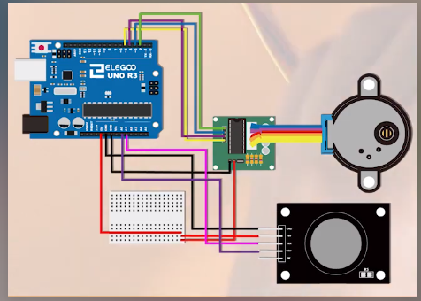
DOMAINS
EEE: The joystick and motor are implemented using a circuit connected via Arduino and power by a 9V battery.
MIA: The joystick was programmed to make the motor rotate clockwise when it is shifted to the right and vice versa.

Slide 7
C. FUNCTIONS.
The phone holder permits the user to execute free rotatory movement in the x- direction using the joystick.
The z-movement is done manually by the user at the trunk level.

Slide 8
D. EXPENSES
Requirements | Quantity | Price in FCFA
Arduino UNO card | 1 | 5000fcfa
Stepper motor with its drive | 1 | 4500fcfa
Cables (both male-female and male-male) | About 20 for male-female and for 5 male-male. | 1000fcfa
Battery and a jack cable. | 1 each | 2500fcfa
TOTAL |  | =13000FCFA
NB
We have not taking into account the time spent in the FABLAB, which is normally an hour or per day.

Slide 9
E. Betting on the market.
The phone holder is an advance as compared to the ones on the actual market due to;
It’s free movement.
We can both assemble and disassemble when needed (Compactable)
It’s a local product as compare to others, it does not rust or conduct.

Slide 10
F. Environmental Effects
The materials we deal with to fabricate the Phone holder are;
100% recycled materials.
Wood is used naturally(not with chemicals).

Slide 11
G. FAILURES
The first and most damaging failure we had was of mis dimensioning. We had mis dimensioned our pieces which made them smaller than we had anticipated.
The second failure we experienced was the type of motor we wanted and the adaptation to our phone holder.
Initially we wanted a rotating motor so we thought of a small DC 12V motor be we did not have the funds to acquire it neither did we know how to make a circuit with it.
Our only option left was our stepper motor. The inconvenience with this was that it was too large so we needed much material in order for it to be contained and there was the inconvenience of the sphere which could displaced the motor and circuit if we wanted the motor to rotate the circuit.
Our remedy to was to put the stepper motor in the sphere costing once again much material

Slide 12
THANKINGS
We want to specially thank
M. Aurelien for his active support in providing material for printing our pieces
M. Mohamed for his active support in laser cutting our base
Elder Parfait for following the progress of our project.

Slide 13

CONCLUSION
Our phone holder is an optimized piece and if purchased, it is guaranteed to give you an adjustable angle of view of your phone without any strain in adjusting.

